Slide 1

Fundamentals of Computer Design
Summary of section 1.1 to 1.6
Victor Mwai SCT 212-0202/2021

Slide 2
Introduction
Over the years, computer technology has advanced at an incredible pace. Today’s computers are far more powerful than their early counterparts, yet they come at a fraction of the cost. These improvements stem from two main factors:
advancements in hardware and innovations in computer architecture.
The shift from assembly language to high-level programming languages, along with the adoption of standardized operating systems, has played a key role in shaping modern computing.
One of the biggest breakthroughs was the introduction of RISC (Reduced Instruction Set Computer) architecture, which significantly improved performance by optimizing instruction execution and enhancing cache efficiency.

Slide 3

Classes of computers
Over the decades, computers have evolved into different categories based on applications and performance needs:
Mainframe(1960s): Used for large-scale business and scientific computing
Minicomputers(1970s): Smaller, interactive computers for time-sharing
Supercomputers(1970-80s)High-performance machines for scientific computation.
Desktop computers(1980s):Personal computers and workstations that revolutionized individual productivity.
Servers(1990s-present):Powerful machines that provide storage, computing, and networking services.
Embedded systems(200s-present):Computers integrated into everyday devices like smartphones, appliances, and gaming consoles.

Slide 4
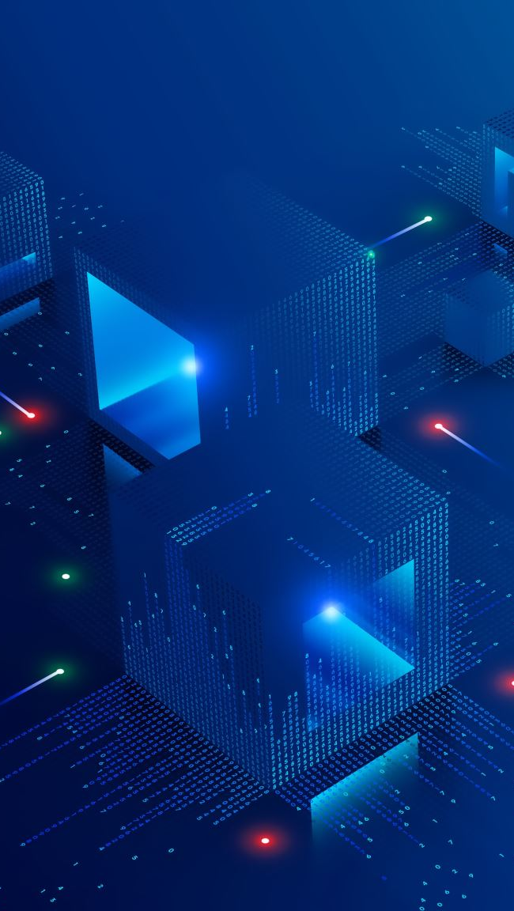
Defining Computer architecture
Computer architecture is all about designing systems that deliver high performance while balancing factors like cost, power efficiency, and reliability. It encompasses several key aspects:
Instruction Set Architecture (ISA) : The interface between hardware and software that defines how instructions are processed.
Functional Organization: The structure and interaction of components like the Arithmetic Logic Unit (ALU), registers, and memory.
Logic Design: The way circuits and logic gates are arranged to perform computations.
Implementation Details: Considerations such as power consumption, cooling mechanisms, and the physical packaging of hardware components.

Slide 5
Trends in technology
Several key trends have shaped the evolution of computer architecture:
Integrated Circuit Advancements: The number of transistors on a chip increases by about 35% per year, leading to more powerful processors
Memory (DRAM) Growth: Storage capacity doubles roughly every two years, improving system performance.
Magnetic Disk Storage: Initially improved at 30% per year, but its growth has become less predictable.
Networking Speeds: Bandwidth has grown much faster than latency improvements, enabling faster data transmission.
As computing needs evolve, there has been a shift from instruction-level parallelism (ILP) to thread-level parallelism (TLP) and data-level parallelism (DLP), requiring changes in how systems are designed to optimize performance.

Slide 6
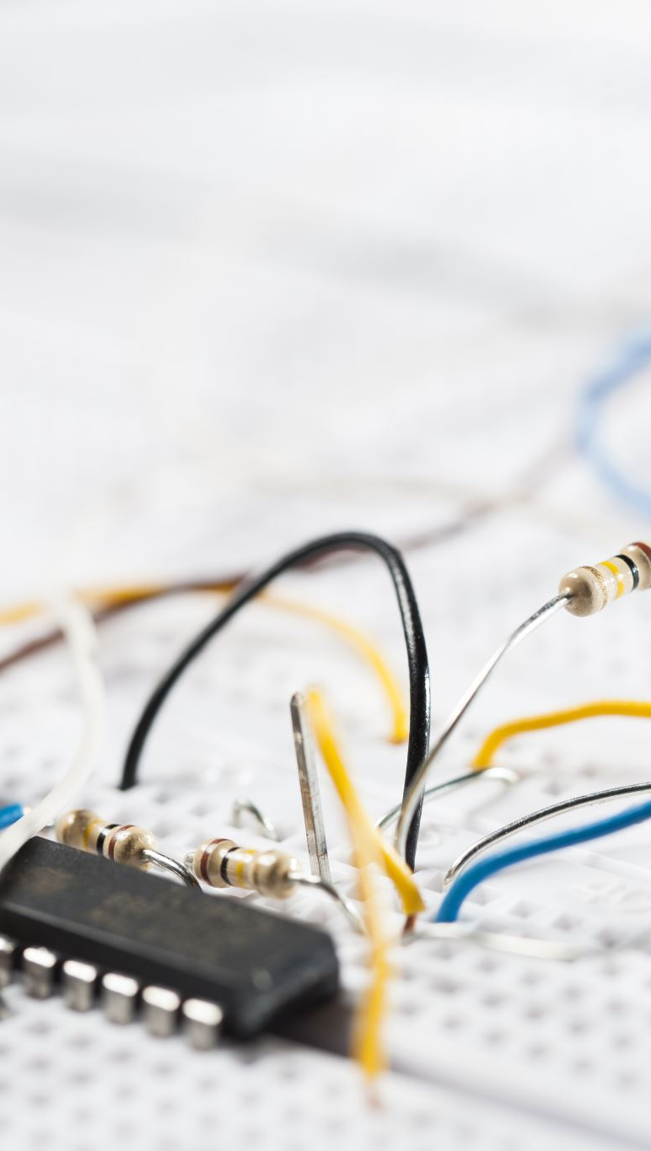
Trends in power in integrated circuits
As transistors shrink, power consumption becomes a major concern in computer design. Several factors influence power usage, including voltage, capacitance, and switching frequency. To tackle power-related challenges, techniques like:
Dynamic voltage scaling (DVS) are used to adjust power consumption dynamically. However, as processors become more powerful, managing heat dissipation remains a significant hurdle..
To address these issues, manufacturers have shifted toward multi-core architectures. Instead of pushing a single processor to its limits, workloads are now distributed across multiple cores, enhancing performance while keeping power consumption in check.

Slide 7

Trends in cost
The cost of building computers is influenced by several factors:
Manufacturing Expenses: Costs depend on materials, fabrication complexity, and production efficiency.
Yield and Defects: As transistor counts increase, the likelihood of manufacturing defects rises, impacting overall production costs.
Scaling and Economics: Advances in technology help reduce the cost per transistor, but companies must balance these improvements with market demand.
Cost-Performance Trade-offs: Striking a balance between affordability and computational power is a key challenge in system design.
Ultimately, cost considerations play a huge role in shaping the future of computer architecture, influencing everything from hardware design to pricing strategies.

